Slide 1

QUICK
CHANGEOVER
Nidheesh Seshadri
Krutika Kanfade
Dinesh Ramachandran
Gautham Muthukumaran

Slide 2
Outline
Introduction
Ways in which quick changeover helps
1. Increased availability of equipment
2. Better response to customer demand (schedule changes)
3. Ability to reduce lots or batch sizes
Single Minute Exchange of Die (SMED)
Implementing Quick Changeovers
1. The Current state
2. Selecting an Area to start
3. Documentation Tools
4. Separating Internal and External Elements
5. Shifting Internal Elements to External

Slide 3



What Is Quick Changeover?
Change of Attire!!!
OFFICE
HOME
PARTY

Slide 4
The Race is Won in the Pits
https://www.youtube.com/watch?v=UPVqq9NpS9o

Slide 5
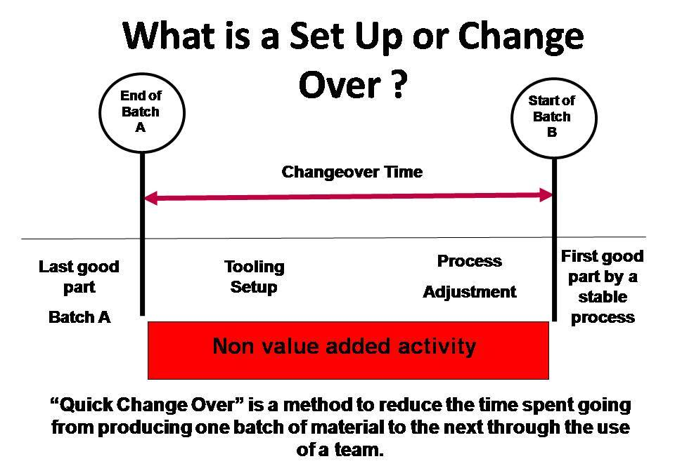
Introduction
http://setupreductiononline.com/

Slide 6

When is the Changeover Complete?
1
Running product A
2
Downtime = Muda or Waste
3
Running product B
http://www.slideserve.com/britney/quick-changeovers-smed-1177291

Slide 7
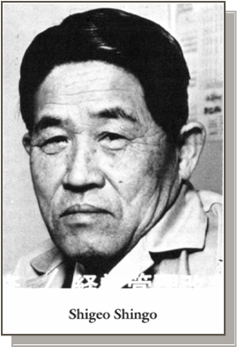
Inventor Of Quick Changeover
Land Cost in Japan were high and hence not feasible to store large inventories of vehicles
Quick Changeover
Reduces the waste of Inventory by creating shorter production runs that better align with customer demand
Developed by
Shigeo Shingo

Slide 8
Eight Rules Of Quick Changeover
Begin with 5S
Transfer internal time to external time
Utilize quick connectors( no bolts needed)
Work from specific positions and standards( no adjusting)
Set and attach ( no fine tuning)
Stay with the machine at all times
Standardize changeover tasks
End with 5S

Slide 9
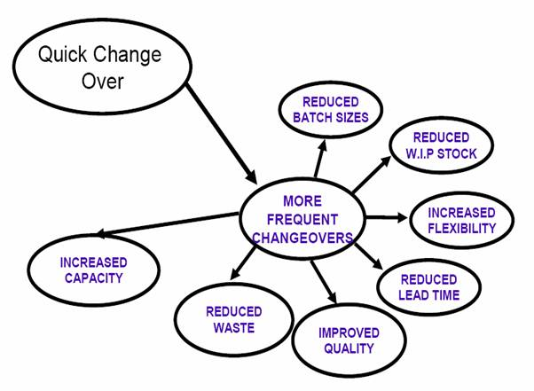
Goals Of Quick Changeover
http://www.mdcegypt.com/

Slide 10
Reduced Batch sizes:
This will help to produce the jobs when there is a need and hence eliminate the storage of the extra ones produced.
Reduced WIP Stock:
As our batch size reduces we need not handle inventory that is required during Work in Progress(WIP).
Increased Flexibility:
As we can produce the jobs as per demand, we become more Flexible.
Reduced Lead Times:
It is the amount of time that elapses between when a process starts and when it is completed, which will reduce on application of Quick Changeovers.

Slide 11
Improved Quality:
As the focus is more on to satisfying customer needs, so Quick Changeovers guarantees improved and best of quality.
Reduced Waste:
As inventory reduces so does the waste.
Increased Capacity:
As now we can produce jobs as and when needed, our capacity will increase.

Slide 12
How TO Reduce The Changeover Time
Minimize or eliminate internal time:
Internal activities are performed while the machine is shut off.
So we eliminate the time the machine is Idle.
Eliminate unnecessary movement:
Unnecessary Motion of machine or product adds to no value and leads to waste.
Also Transportation of Material when not in use also will lead to waste.
Convert internal time to external time:
As internal time is the time machine is idle, hence convert that time to some useful activity so that the overall time tends to reduce.

Slide 13
Benefits Of Implementing Quick Changeover
Reduce Inventory
Reduce Batch sizes
Reduce Inventory times
Reduce impact on equipment utilization
Improve quality after changeover
Improve repeatability
Improve throughput
Improve flexibility

Slide 14
Look For…
Look for opportunities to eliminate waste in your changeovers, then go after them.
In the following video, identify any wasteful activities.
https://www.youtube.com/watch?v=UlIGI3laGAo

Slide 15
Single Minute Exchange Of Die (SMED)
SMED was developed by Shigeo Shingo in Japan in the sixties and early seventies at Toyota and other Japanese firms.
The impetus was to reduce costly inventories and Improve efficiency.
An important foundation to the SMED system is the distinction between changeover work that occurs while the machine is not running, called Internal Setup, and preparatory work that occurs while the machine is running, called External Setup. At the point in time when SMED was developed, almost all changeover work was performed while the machine (press) was down.

Slide 16
The SMED philosophy breaks down into four stages:
In the preliminary stage, all setup work is combined. There is no distinction between internal and external work.
In the second stage, external setup and internal setup are identified and separated.
In the third stage, work that was previously included in the internal setup is transferred to external setup.
The fourth stage requires relentless and continuous improvement of all work elements within the internal and external setup (Kaizen).

Slide 17
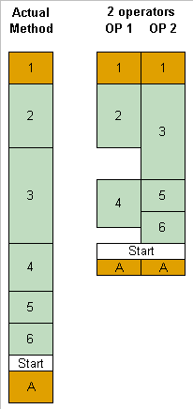
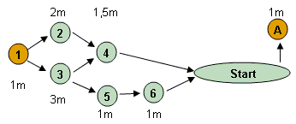
Teamwork - Parallel Operations Using Multiple Operators
Level load the changeover
Balance the tasks

Slide 18
Steps Involved In Single Minute Exchange Of Die (SMED)
OBSERVE and RECORD
Separate INTERNAL and EXTERNAL activities
Convert INTERNAL activities TO EXTERNAL activities.
STREAMLING all the ACTIVITIES
DOCUMENTING the INTERNAL and EXTERNAL ACTIVITIES

Slide 19

Observe And Record
In this initial stage of the quick changeover process, the whole setup is observed and recorded to identify the internal and external elements of the system.
To record the waste/lost time
To identify different countermeasures to improve the process.
To compare the standard process with an improved process to check the effectiveness.
This step does not work on reducing the people or eliminating jobs.

Slide 20
Separate Internal And External Activities
INTERNAL ACTIVITIES: These are the operations that can be performed only when the machine is stopped. This activity requires the system to stop to change the tools or parts before proceeding with the operation.
Example: Removing the tool can be done only when the machine is stopped; Removing the tire from a Formula 1 car is possible only when the car comes to a stop.
EXTERNAL ACTIVITIES: These type of operations can be performed while the machine is running. This means we can save time by performing this activity without affecting the on-going operation.
Example: Making preps for the initial setup of the changeover and arranging the necessary parts and tools required for the changeover.
Both INTERNAL ACTIVITIES and EXTERNAL ACTIVITIES need to be identified and separated before proceeding with the changeover to simplify the process.

Slide 21
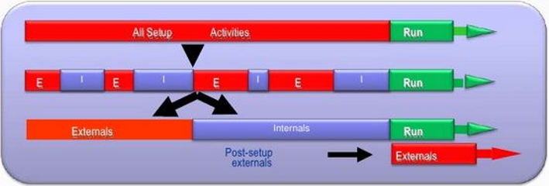
Separating INTERNAL and EXTERNAL Processes

Slide 22
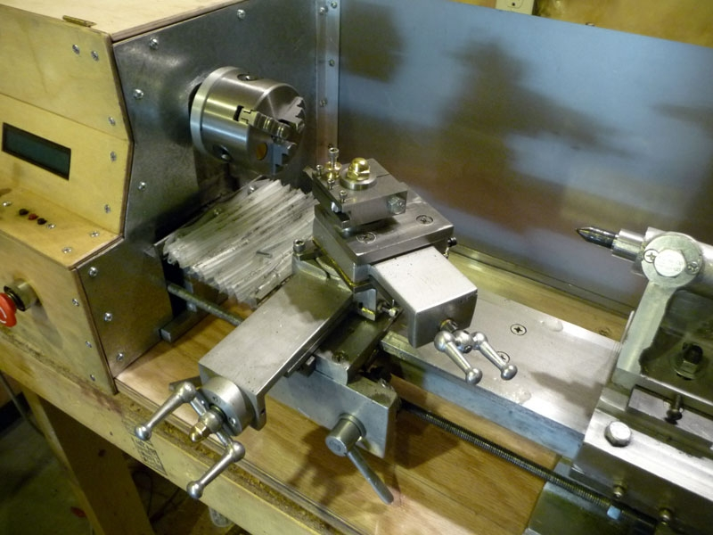
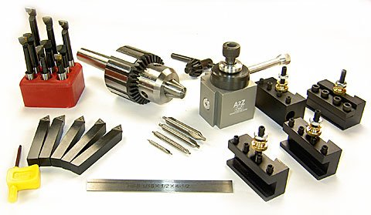
INTERNAL PROCESSES
INTIAL PREPARATION BEFORE CHANGOVER – EXTERNAL PROCESS

Slide 23
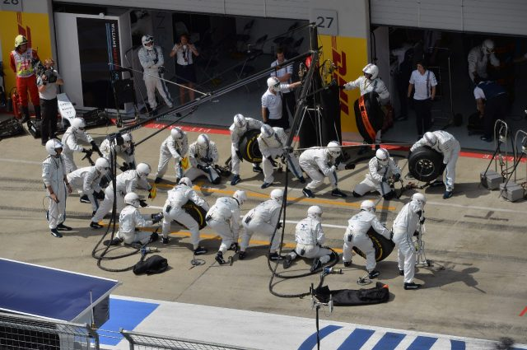
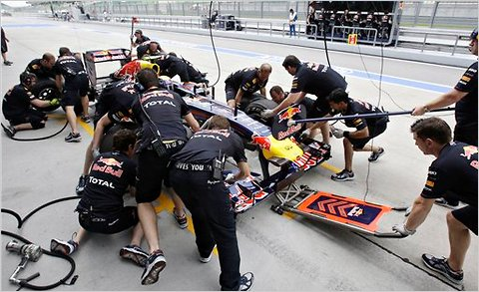
INTERNAL PROCESS
EXTERNAL PROCESS

Slide 24
Converting Internal Activities Into External Activities
Converting the internal activities into external activities helps reduce the labour and time involved in the changeover.
How to convert internal activities into external activities: Here we are using the “5S” of lean…..
Eliminating search-and-find work (i.e.) organizing things for easy accessibility.
Arranging tools and materials beforehand.
Completing the prep work before commencing the changeover process.
Standardizing the settings to help locate tools and materials easily.
Making visual marks and trial-error adjustments to get the optimum the result.
Eliminating the trial runs.
Postpone “put away” work.
The main aim of this step is to reduce the number of internal activities
to save time and reduce waste (BEING LEAN !).

Slide 25
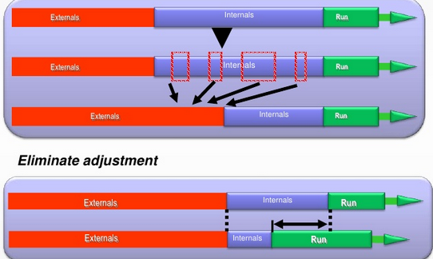
CONVERTING INTERNAL ACTIVITIES IN TO EXTERNAL ACTIVITIES

Slide 26
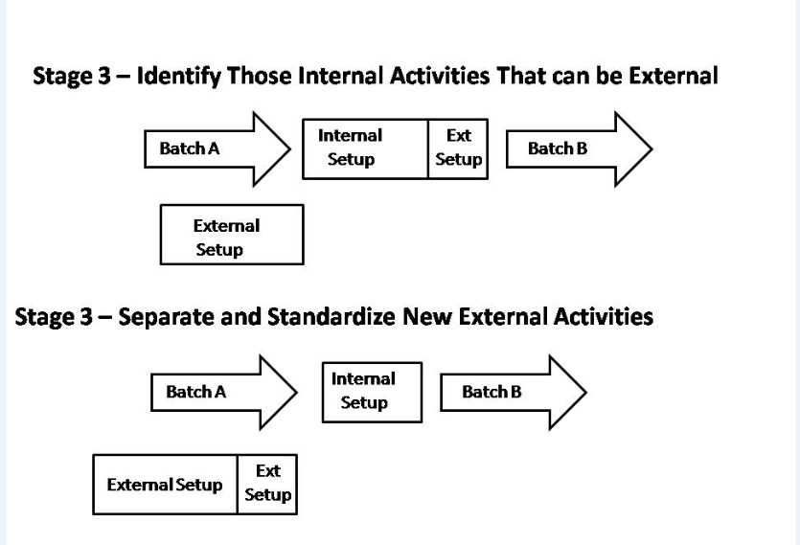

Slide 27
Streamlining All The Activities
Streamlining the internal and external activities to eliminate waste and any possible errors that could affect the production.
STREAM LINING THE INTERNAL ACTIVITIES:
Creating parallel steps while completing the on-going work.
Reducing complexity to avoid confusion and eliminating waste by:
Using functional jigs and fixtures such as on motional fasteners, levered or one-turn fasteners, inter-locking wedge or slot.
Eliminating adjustments by using angle and flat; using preset pins, gauges, notches, etc.
Eliminating the need to leave the machine during changeover.

Slide 28
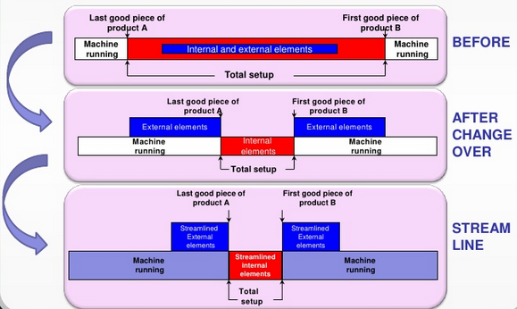
Streamlining The External Activities
Adopt functional standards such as:
Visual factory locations for tools
Colour coding
Standard set ups
Checklist

Slide 29
Documenting The Internal And External Activities
CREATING A NEW PROCESS:
A document is prepared describing about who will do what and when.
Practicing the quick changeover before doing it.
TESTING THE NEW PROCESS:
Running a set of new processes:
Documenting the steps of the new process
Recording the time steps of the new process
Videotaping the new process to find additional opportunities
Making adjustments as required
Re-test the new process if necessary
DOCUMENTING THE NEW PROCESS:
Creating new worksheets that include all the steps of the new process
Get all the needed approvals
Train all the workers with the new process
Post the standardized worksheets (Making it Visual!)

Slide 30
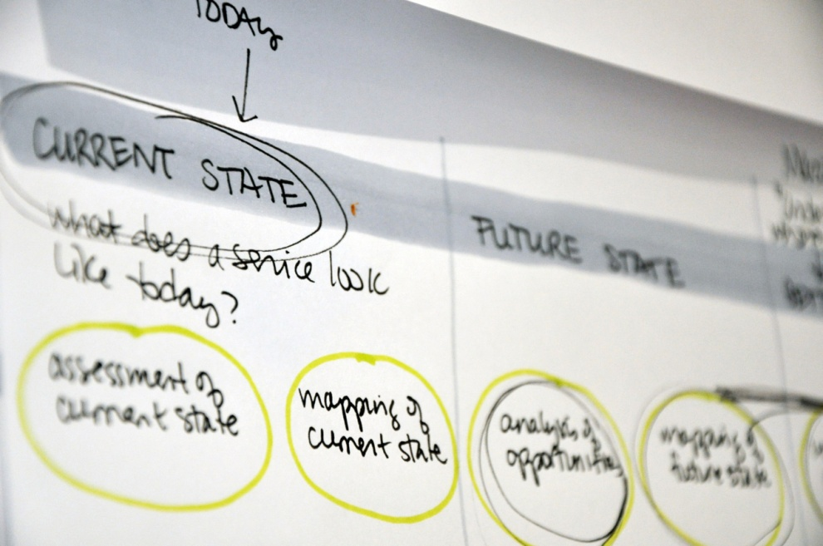
Implementing quick changeovers
The current state
Improvement might take place, How do you know??
First step when implementing any kind of improvement is to understand the current state
Understand current methods and procedures and the measurements associated with the task

Slide 31

Selecting an Area to Start
High probability of success
Think about
Current methods
Willingness of the workforce to make changes
Leadership
Relationship with workforce
Localised current practises and changeover techniques

Slide 32
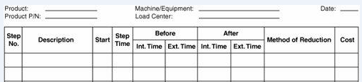
Documentation Tools
Document/ Videotape the current changeover process
Participation of everyone on the plant floor in improvement- Strongly recommend

Slide 33
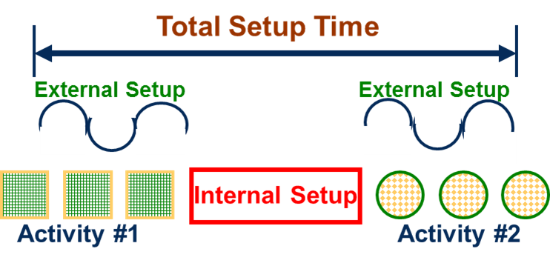
Separating Internal and External Elements
Determine Internal and External elements
In-depth documentation
Internal Elements
Operations performed while machine is not running
External Elements
Operation performed while machine is running

Slide 34
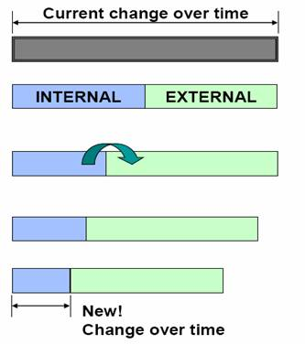
Separating Internal and External Elements
The primary goal is to reduce the time, the machine is not running
20-40% improvement is possible at this stage
Analyze every internal element and shift externally

Slide 35

THANK YOU

